Slide 1
The Parallel Axis Theorem
Dr. Jacob Moore
Associate Professor of Mechanical Engineering
Penn State Mont Alto

Slide 2
The Parallel Axis Theorem
As we saw in the previous sections, the area and mass moments of inertia we calculate depend on the origin point that we set at the start.
We can illustrate this by trying to rotate a broomstick about different points.
It will be easier to rotate about the center point (lower mass moment of inertia).
It will be harder to rotate about the end point (higher mass moment of inertia).

Slide 3
The Parallel Axis Theorem
Because we could potentially choose any point to rotate the body about, there are potentially an infinite number of moment of inertia values.
Even though there are an infinite number of values, they will go up and down in a predictable fashion, and we can use the moment of inertia at one point, to find the moment of inertia at another point using the parallel axis theorem.

Slide 4
The Parallel Axis Theorem
The parallel axis theorem state that…
The moment of inertia will be lowest at the centroid / center of mass
Centroid for area moments of inertia
Center of mass for mass moment of inertia
If we were to take the moment of inertia about another parallel axis that is distance “r” away from the original axis, then the moment of inertia value would increase by a quantity of area/mass times distance squared.

Slide 5

The Parallel Axis Theorem
The parallel axis theorem states that...
$$I_{xP}=I_{xC}+Ar^{2}$$
or...
$$I_{xxP}=I_{xxC}+mr^{2}$$
Area Moment about Any Point P
Distance between the two x axes
Area Moment about Centroid
Area of Shape
Mass Moment about Any Point P
Distance between the two x axes
Mass Moment about Centroid
Mass of Part

Slide 6



The Parallel Axis Theorem and Area Moments of Inertia
For area moments of inertia, it is important to identify how far the axis has moved, not just how far the point has moved.
Because we are squaring the r term, the direction isn’t important.
y
$$r_{y}$$
C
x
$$r_{z}$$
y
$$r_{x}$$
P
x

Slide 7



The Parallel Axis Theorem for Mass Moments of Inertia
With the mass moment of inertia, we will also need to be careful to determine how far the axis is moving.
Also be aware this doesn’t work if we are changing the direction of the axis of rotation.
$$r$$
$$P$$
$$C$$

Slide 8
The Method of Composite Parts and the Parallel Axis Theorem
Just as we had for the centroid calculations, we can use a similar method of composite parts to calculate the area and mass moments of inertia using moment of inertia tables for common shapes
An important part of the process will be using the parallel axis theorem to adjust the moments of inertia so that they are all taken about a common point before adding them all together.

Slide 9
Thanks for Watching
See other engineering mechanics videos and access the full tool at…

Slide 10
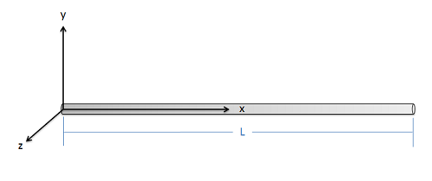
Parallel Axis Theorem Worked Example
Use the parallel axis theorem to find the mass moment of inertia of this slender rod with mass m and length L about the z axis at its end point.

Slide 11




Mass Moment of Inertia Worked Example
A semicircular thin plate has constant density, a radius of 10 cm, and a mass of 400 g. Find the mass moment of inertia of the plate around the axes (a) x and (b) z passing through the center of mass.
$$y$$
$$y$$
$$x$$
$$z$$
G
FRONT VIEW
SIDE VIEW

Slide 12
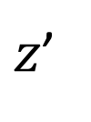






Mass Moment of Inertia Worked Example
A semicircular thin plate has constant density, a radius of 10 cm, and a mass of 400 g. Find the mass moment of inertia of the plate around the axes (a) x and (b) z passing through the center of mass.
$$y$$
$$y, y′$$
$$y′$$
$$x$$
$$z$$
G
G
$$x′$$
$z$’
A
A
FRONT VIEW
SIDE VIEW

